Slide 1


Slide 2
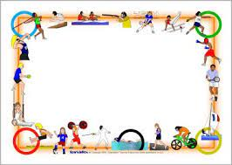

SHORT TERM INTERNSHIP
Data-Driven Insights on Olympic Sports Participation and Performance

Slide 3

SREE VIDYANIKETHAN DEGREE COLLEGE
BACHELOR OF SCIENCE
TEAM MEMBERS
1. R. SANDHYA
2. N. PRIYANKA
3. C.H. VINEELA
4. G. LAKSHMI DEVI
5. S. MAHAMMAD ARIF
6. B. HEMANTH
Guided By : Team ID:
DR. S. Asif Alisha LTVIP2023TMID10823
Ms. S. Vasiha Anjum

Slide 4

PROJECT CONTENTS
Data preparation
Data visualization
Dash board
Story
Report
performance testing
Web integration

Slide 5

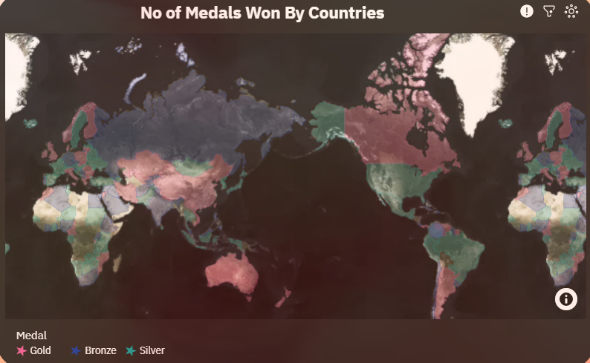
DATA VISUALIZATIONS
DATA VISUALIZATIONS
This map contains No. of medals won by different countries.
Location contains region, location color contains medal and tool kit contains medal count.
And that medal contains only the Gold, silver, bronze do not contain NA values.
skyblue colour represents gold, violet colour represents bronze and red colour represents silver medals.

Slide 6
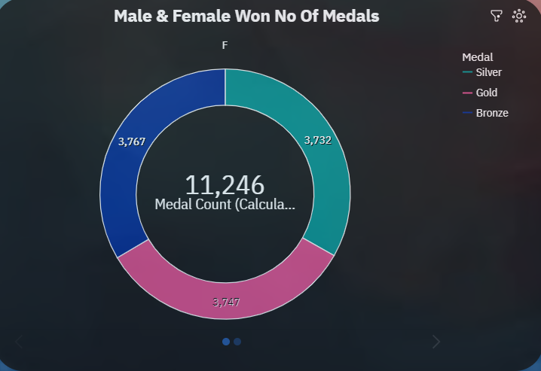
This pie chart represents the no of medals won by both males and females from different years.
This contains segments i.e medal size contains medal count and repeat contains sex which is column.
skyblue colour represents gold, violet colour represents bronze and red colour represents silver medals.

Slide 7
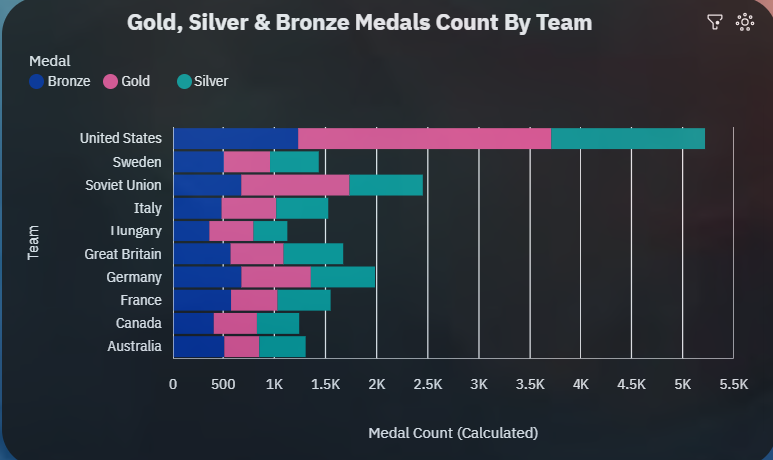
This bar chart represents the gold, silver, bronze medals counts by team.
In this the bars contains team and length contains medal count.
skyblue colour represents gold, violet colour represents bronze and red colour represents silver medals in different countries.

Slide 8
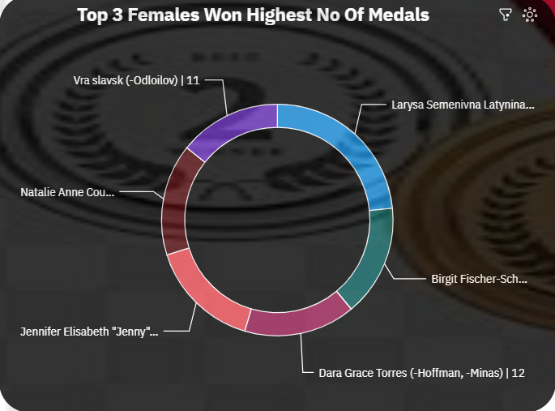
STORY
This pie chart represents the no of medals won by both males and females from different years.
This contains segments i.e medal size contains medal count and repeat contains sex which is column.
skyblue colour represents gold, violet colour represents bronze and red colour represents silver medals.

Slide 9
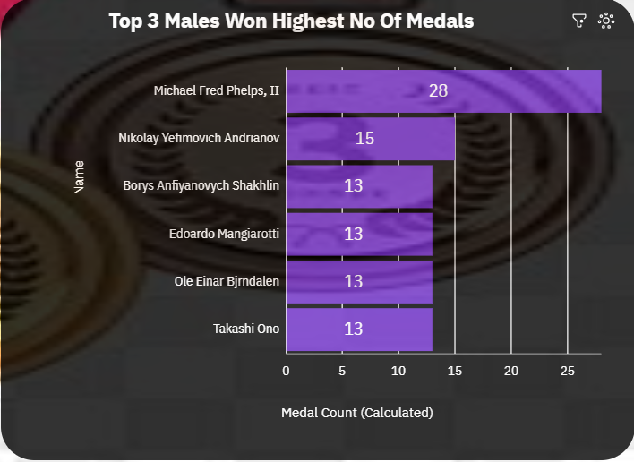
Top 3 Males won highest no. of Medals overall
In X-axis we taken Names where as in Y-axis we taken Medal Count
Highest No. of medals won by Michael Fred i.e.,28
Top 2nd is Nikolay won no. medals are 15
Top 3rd is Borys Anfiyanovych won no. medals are 13

Slide 10
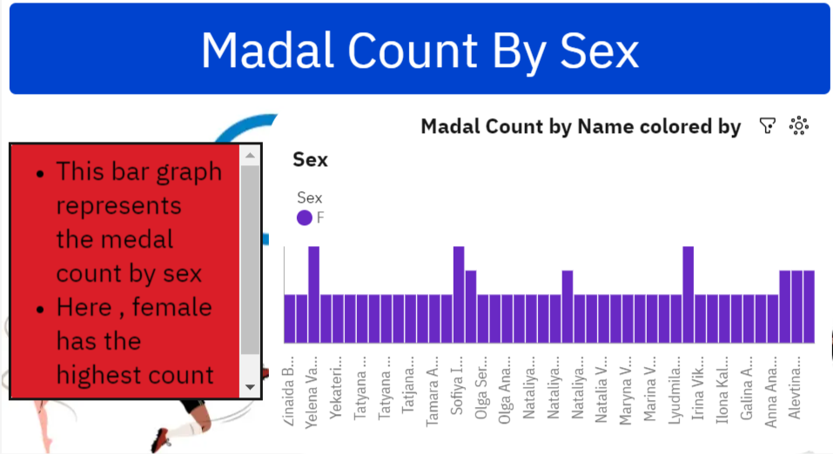

Slide 11
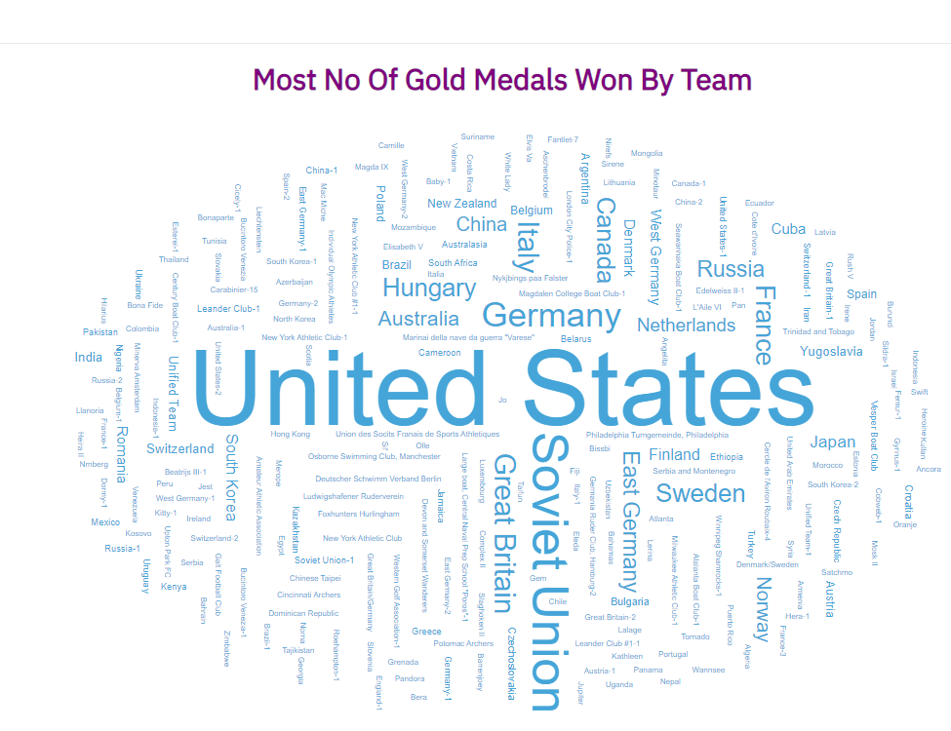
REPORT

Slide 12
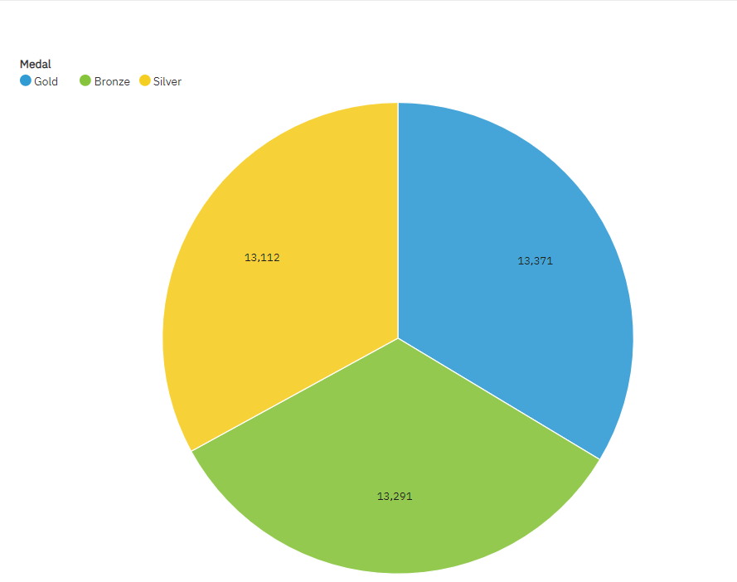
Gold Have Most No Of Medals Won In Olympic

Slide 13
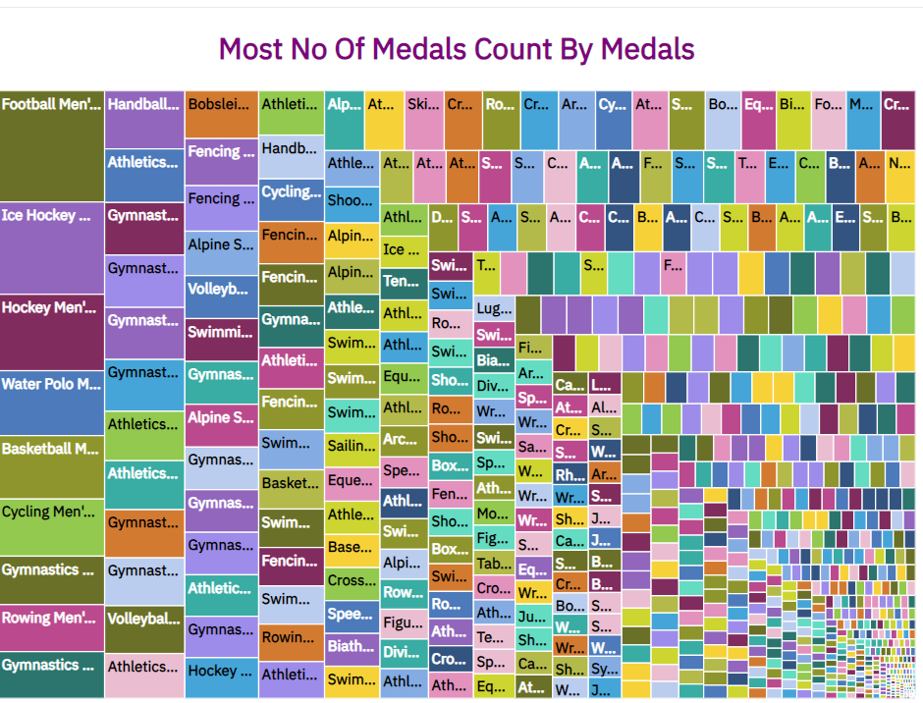

Slide 14
WEB INTEGRATION LINK
http://127.0.0.1:8000

Slide 15
DASHBOARD LINK
https://us3.ca.analytics.ibm.com/bi/?perspective=dashboard&pathRef=.my_folders%2FOlympic%2BEvents%2Bdashboard&action=view&mode=dashboard&subView=model0000018b3244a019_00000002
STORY LINK
https://us3.ca.analytics.ibm.com/bi/?perspective=story&pathRef=.my_folders%2FOlympic%2BEvents%2Bstory&action=view&sceneId=model0000018b3390a7c2_00000000&sceneTime=0
REPORT LINK
https://us3.ca.analytics.ibm.com/bi/?pathRef=.my_folders%2FP%2BOlympic%2BEvents%2BReport&action=run&format=HTML&prompt=false

Slide 16
STUDENT DETAILS
1. Name: Rayalla Sandhya 2. Name: N. Priyanka
Hall ticket no: 0322022131 Hall ticket no:0322022122
Admin no: BSCMSCS2021010 Admin no:BSCMSCS2021029
Email Id: rayallasandhya7@gmail.com Email Id: nellorepriyanka15@gmail.com
3. Name: C.R. Vineela 4. Name: G. Lakshmi devi
Hall ticket no: 0322022108 Hall ticket no: 0322022096
Admin no: BSCMSCS2021022 Admin no: BSCMSCS2021025
Email Id: vineela9014@gmail.com Email Id: gundalapallilakshmi@gmail.com
5. Name : S. Mahammad Arif 6. Name : B. Hemanth
Hall ticket no : 0322022134 Hall ticket no :0322022079
Admin no: BSCMSCS2021026 Admin no : BSCMSCS2021031
Email Id: sarifarif2003@gmail.com Email Id: bhemanth68@gmail.com

Slide 17


